Slide 1

Fundamentals of IT and networking
By: Kassandra Moreno

Slide 2
Introduction This presentation will show the foundations of networking and IT fundamentals. I learned ipv4 addressing, connectivity testing, subnetting, loopback interfacing, network diagraming, and wireless network security in the past eight weeks.

Slide 3
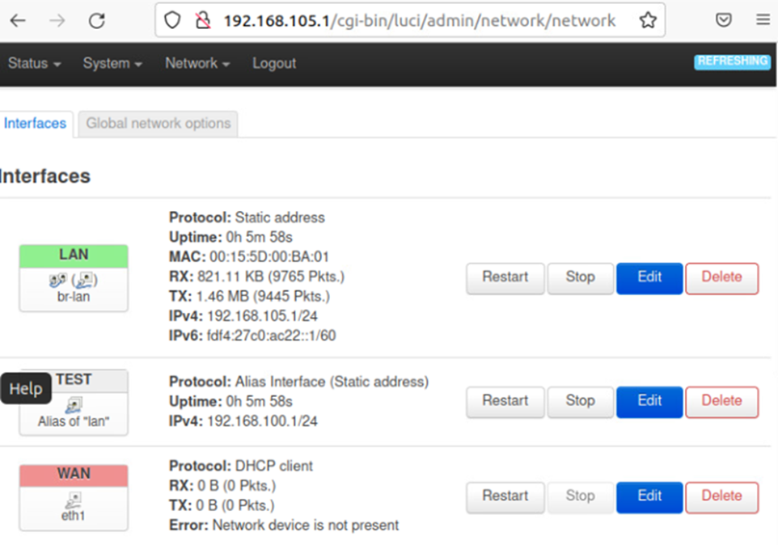
Module 2 IPv4 Addressing Learning how to implement an IPv4 addressing scheme to support a network. The image on this slide shows the implementation of a new IPv4 address on a LAN interface.

Slide 4
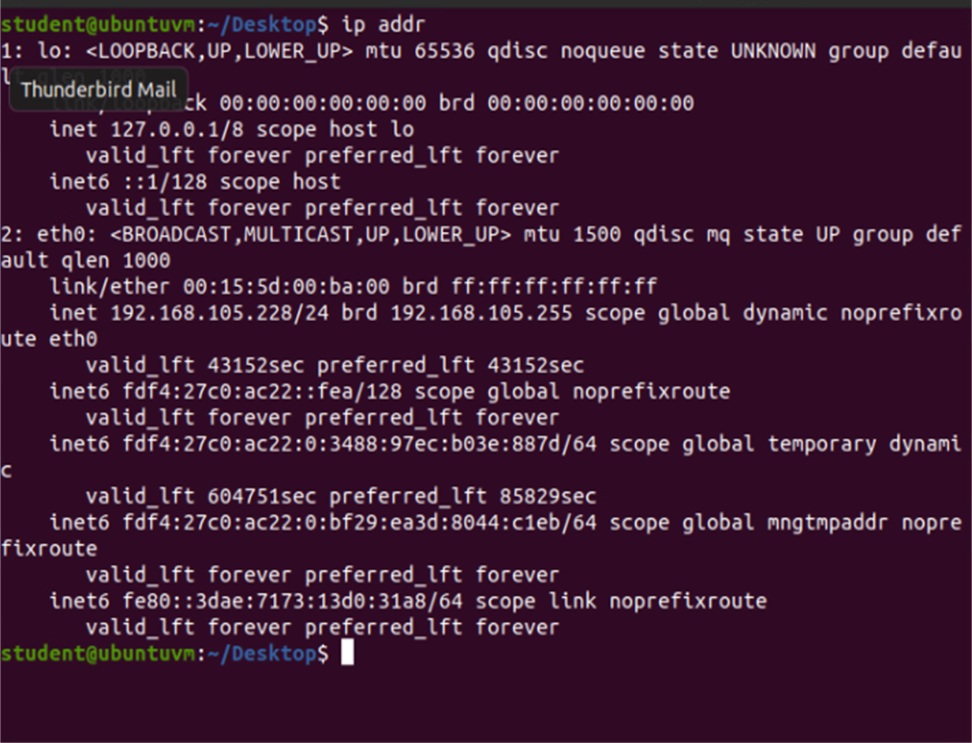
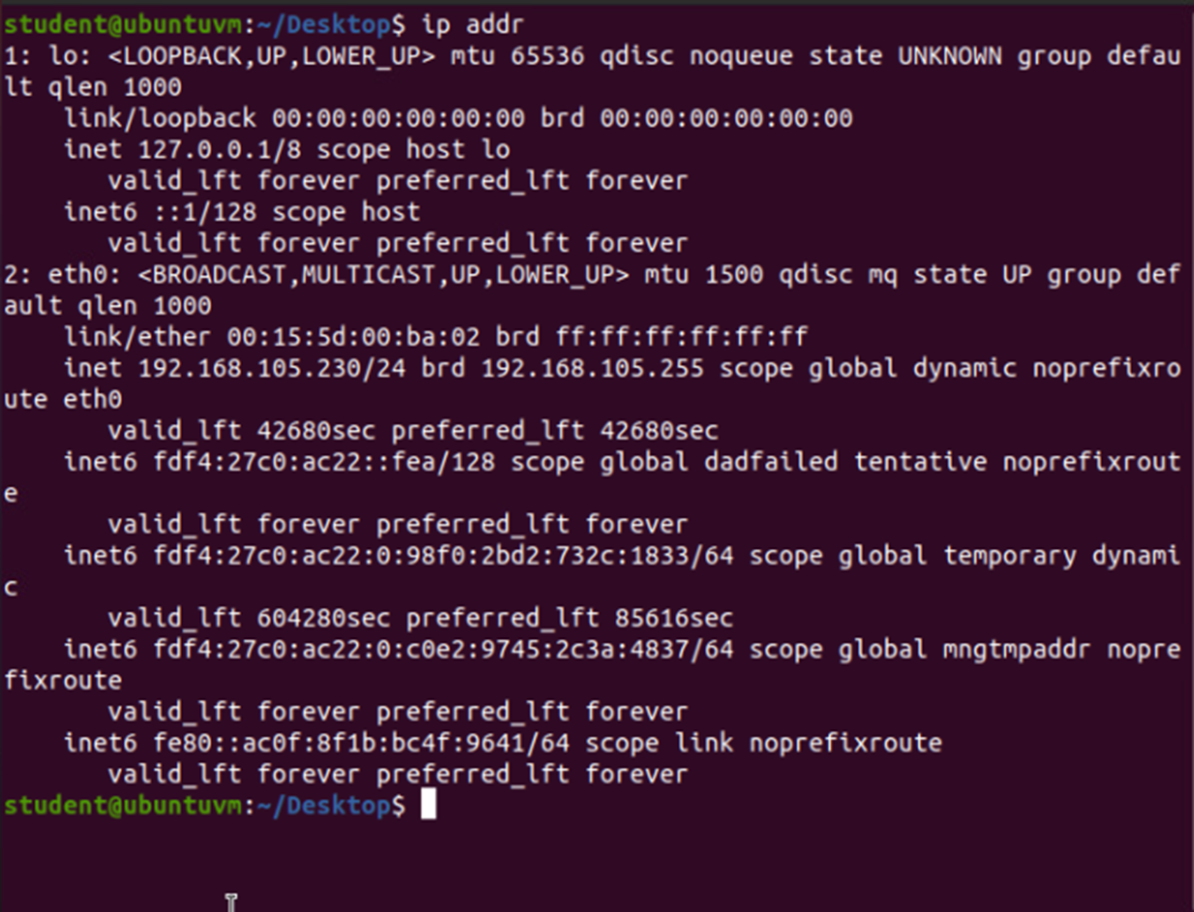
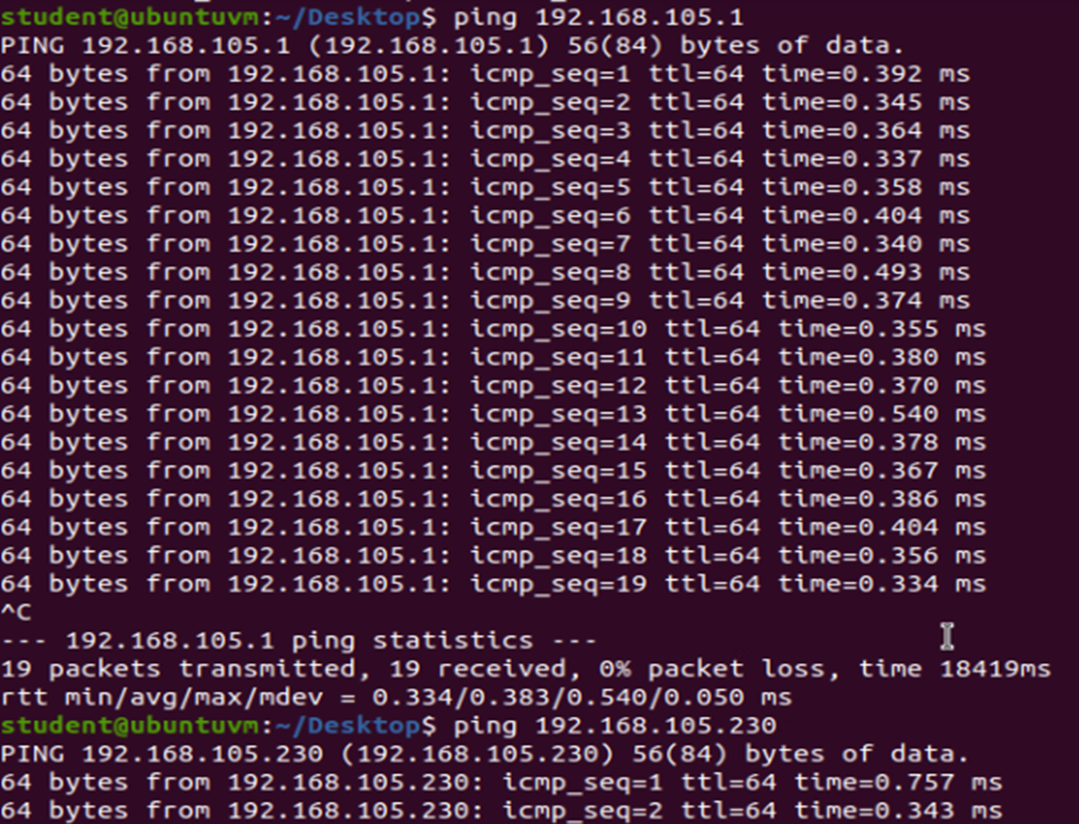
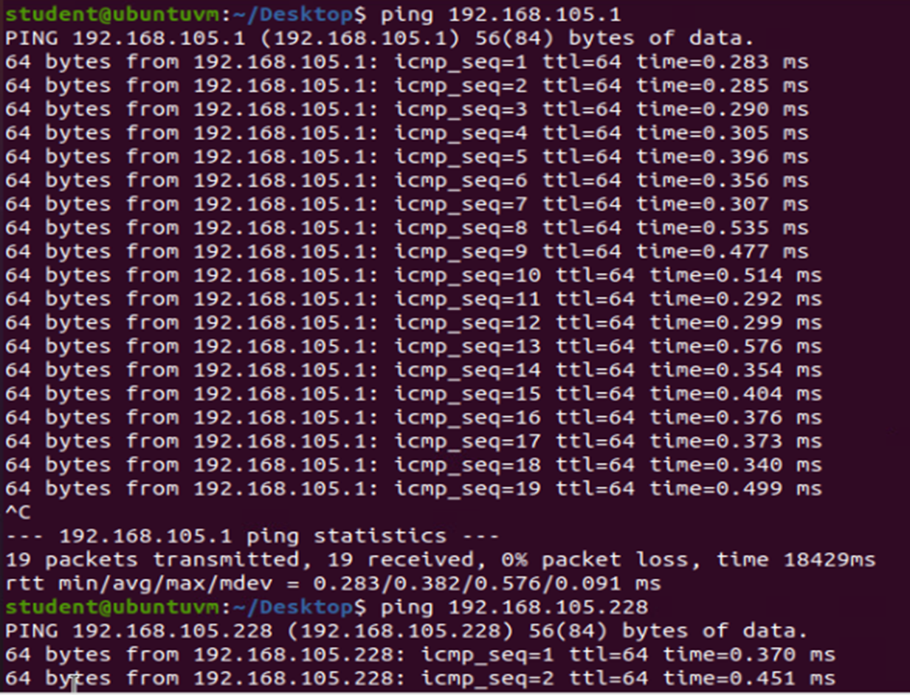
Module 3 Connectivity Test Learning how to test connections between two or more devices. The images on the right display the commands and results.
VM 1:Dynamic IP Address Alignment
VM 2:Dynamic IP Address Alignment
Computer 1 Connectivity to Computer 2
Computer 2 Connectivity to Computer 1

Slide 5
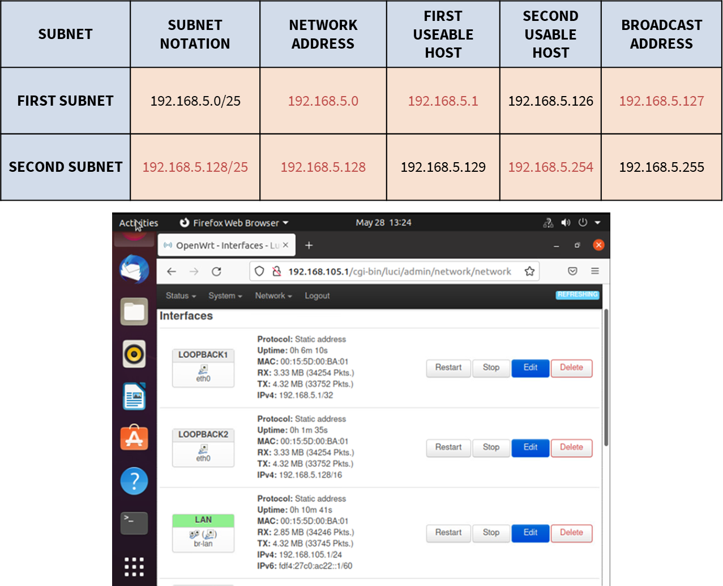
Module 4 IP Subnetting and Loopback Interfaces Learning how to subnet and display loopback interfaces. The images here show a subnetting table (black print indicates what I was given, and red print indicates what I solved), and loopback 1 and loopback 2 interfaces with their respective IPv4 addresses.

Slide 6
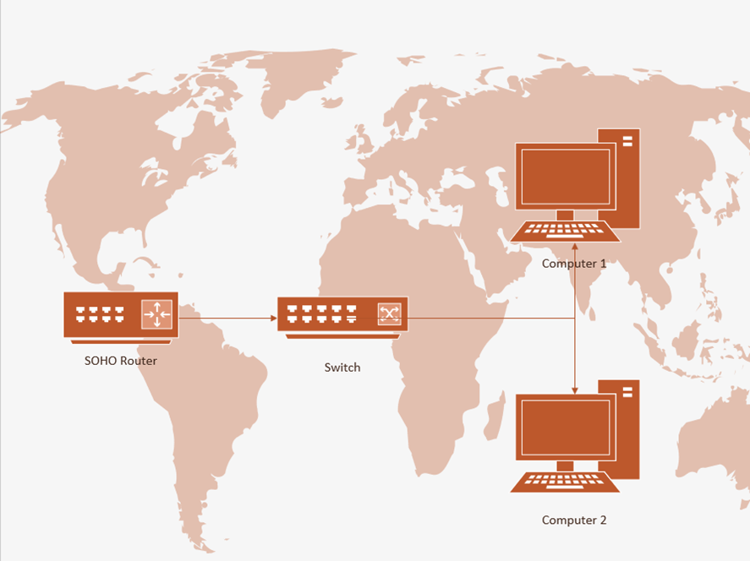
Module 5 Visio Network Diagram This image indicates The network diagram of the previous demonstrations

Slide 7
Module 6: Wireless Network Security
1. What are the factory default username and password of a TP-Link router? Why is it important to change the default username and password of a SOHO router?
Answer: The factory default username and password of a TP-Link router is your router's administrative access username and password. It is essential to change this for countermeasures toward cyber attacks.
2. To protect a SOHO wireless network with a few devices, which address management method provides more control, manually configuring the device IP addresses (static IP) or using a DHCP server (dynamic IP)? Why?
Answer: When dealing with a SOHO wireless network it is better to use static IP addressing because it is more secure. Dynamic IP addressing is typically used with larger uses because it is needed to keep up with changes and the network. Generally, static is the safest option, and best used when dealing with smaller groupings.
3. What does MAC filtering do? If needed, when would you use deny filtering rules and when would you use allow filtering rules? What happens to devices that want to connect, if the “Allow the stations specified by any enabled entries in the list to access” function is enabled but there are no entries in the list?
Answer: The wireless MAC address filtering feather gives you control over the wireless stations accessing a specific access point. You would deny filtering rules when you don’t want t filter the accessing stations, and you would allow filtering when you want to filter the stations. The device will be denied if a device wants to connect without entries on the list.
4. What wireless security settings are displayed on the Wireless Security page? Which one is recommended by the vendor? Why?
Answer: The wireless security setting displayed on the security page are WPA/WPA2- Personal, WPA/WPA2- Enterprise, and WEP. The vendor has recommended WPA/WPA2 Personal because of a pre-shared passphrase.
5. Among the configurations you explored in this module, which one is a proper security function? Why?
Answer: I feel that all of the configurations explored were ‘true’ security functions. I believe it all depends on what you are doing with your wireless network.
6. What would you do to protect your wireless network at home? Why?
Answer: I would follow recommended procedures by my network providers.

Slide 8
Challenges My greatest challenge in the last eight weeks was learning how to subnet. The challenge was self-induced, given that I hadn’t completed my reading on the topic before attempting it. After completing the reading, subnetting made a lot more sense, and I could move on through the rest of the course with the knowledge and understanding of subnetting. I even came to enjoy it.

Slide 9
Conclusion I have briefly learned Ipv4 addressing, connectivity testing, subnetting, loopback interfacing, network diagraming, and wireless network security in the past eight weeks. Each of the slides you have reviewed displays my first attempt at these topics but not my last.

Slide 10
Career Skills The career skills obtained through this experience are basics but necessities. In the career path I am currently in. I find all of the topics I’ve learned to be career skills obtained. To sum it up, I would say the career skill I’ve gathered in the last eight weeks is networking fundamentals.

